Slide 1
CENG401 MACHINE LEARNING AND ARTIFICIAL INTELLIGENCE
WEEK-3
INTELLIGENT AGENTS
Asst.Prof.Dr. Murat ŞİMŞEK

Slide 2
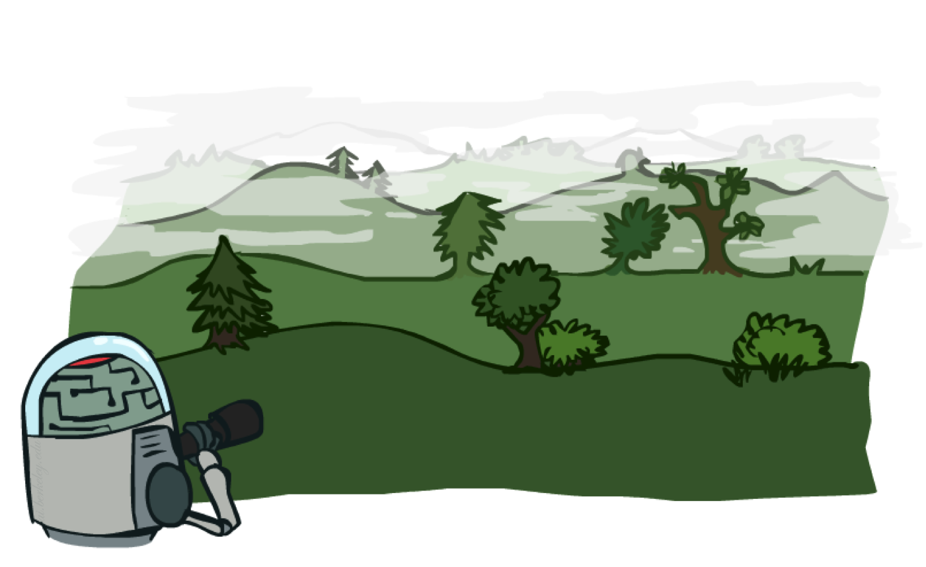
SOLVING PROBLEMS BY SEARCHING
Notes:
Intelligent agents are supposed to maximize their performance measure.

Slide 3

SOLVING PROBLEMS BY SEARCHING
Notes:
Intelligent agents are supposed to maximize their performance measure.

Slide 4

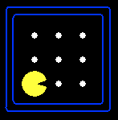
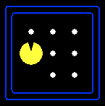
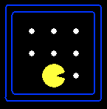
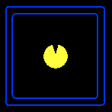


Search Problem
A search problem consists of:
A state space
A successor function
(with actions, costs)
A start state and a goal test
A solution is a sequence of actions (a plan) which transforms the start state to a goal (final) state
“N”, 2.0
“E”, 2.0

Slide 5

Search Problem
Under these assumptions, the solution to any problem is a fixed sequence of actions.
Notes:
Search Problems are our models for solving problems.

Slide 6
Search Problem
The process SEARCH of looking for a sequence of actions that reaches the goal is called search.
A search algorithm takes a problem as input and returns a solution in the form of an action sequence.
Once a solution is found, the actions it recommends can be carried out. This EXECUTION is called the execution phase.
While the agent is executing the solution sequence it ignores its percepts when choosing an action because it knows in advance what they will be. This is OPEN-LOOP
Notes:
Search Problems are our models for solving problems.

Slide 7
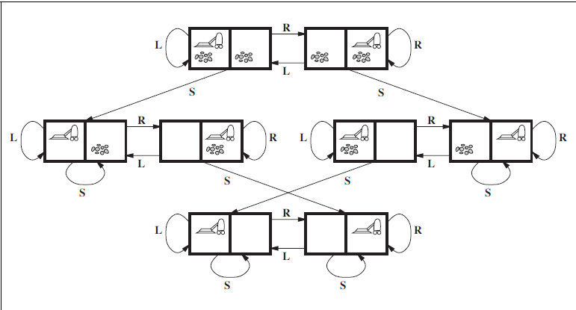
Search Problem

Slide 8
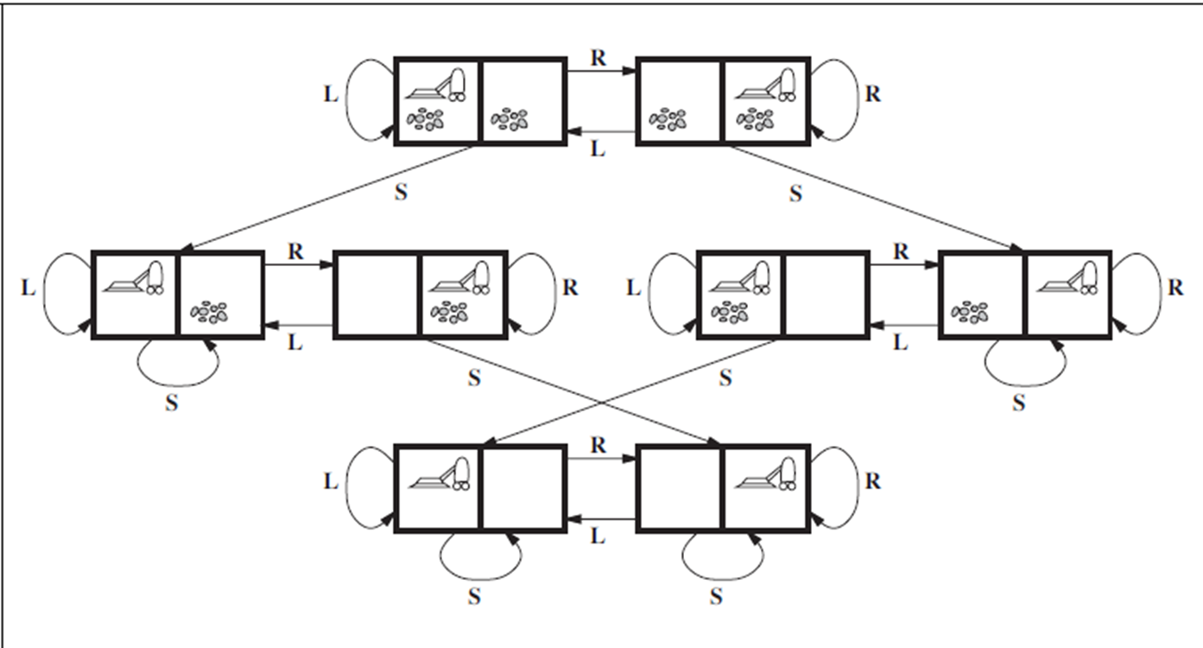
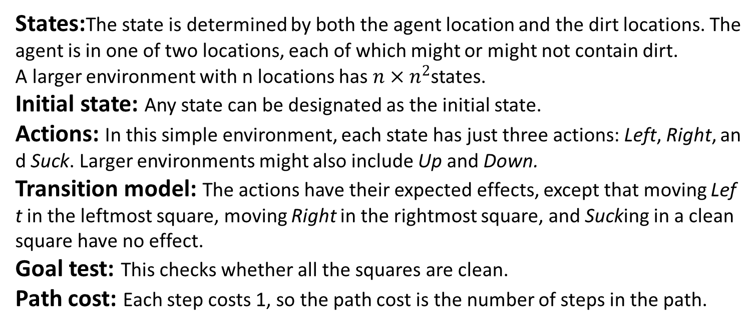
Formulating problems
States:The state is determined by both the agent location and the dirt locations. The
agent is in one of two locations, each of which might or might not contain dirt.
A larger environment with n locations has $n×n^{2}$states.
Initial state: Any state can be designated as the initial state.
Actions: In this simple environment, each state has just three actions: Left, Right, and Suck. Larger environments might also include Up and Down.
Transition model: The actions have their expected effects, except that moving Left in the leftmost square, moving Right in the rightmost square, and Sucking in a clean square have no effect.
Goal test: This checks whether all the squares are clean.
Path cost: Each step costs 1, so the path cost is the number of steps in the path.

Slide 9
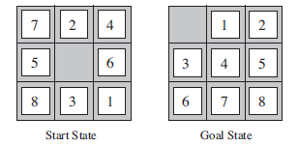
Example
States
Initial state
Actions
Transition model
Goal test
Path cost

Slide 10
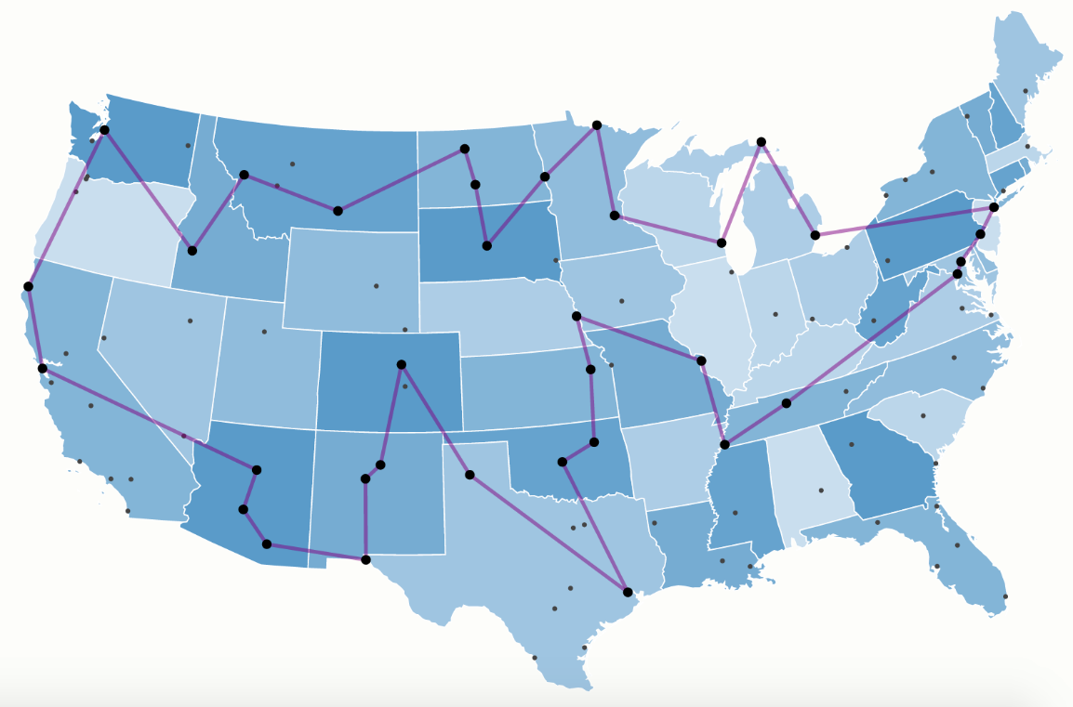
State Space Search Algorithms
State space:
Cities
Successor function:
Roads: Go to adjacent city with cost = distance
Start state:
LA
Goal test:
Is state == NewYork?
Solution?

Slide 11
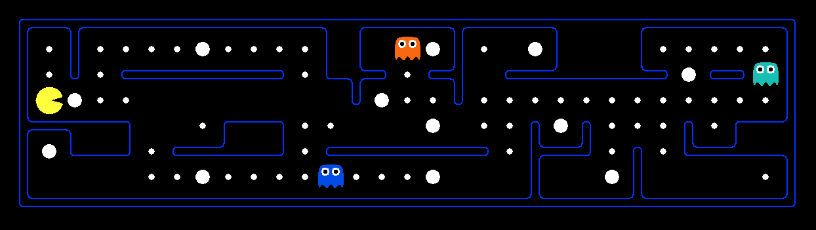
What’s in a State Space?
The world state includes every last detail of the environment
Problem: Pathing
States: (x,y) location
Actions: NSEW
Successor: update location only
Goal test: is (x,y)=END
Problem: Eat-All-Dots
States: {(x,y), dot booleans}
Actions: NSEW
Successor: update location and possibly a dot boolean
Goal test: dots all false

Slide 12
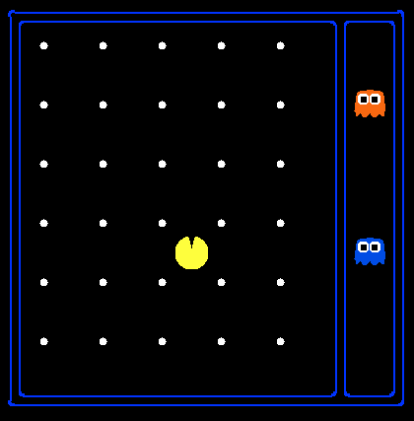
State Space Sizes?
World state:
Agent positions: 120
Food count: 30
Ghost positions: 12
Agent facing: NSEW
How many
World states?
120x(2³⁰)x(12²)x4
States for pathing?
120
States for eat-all-dots?
120x(2³⁰)

Slide 13
State Space Graphs
State space graph: A mathematical representation of a search problem
Nodes are (abstracted) world configurations
Arcs represent successors (action results)
The goal test is a set of goal nodes (maybe only one)
In a state space graph, each state occurs only once!
We can rarely build this full graph in memory (it’s too big), but it’s a useful idea

Slide 14
State Space Graphs
State space graph: A mathematical representation of a search problem
Nodes are (abstracted) world configurations
Arcs represent successors (action results)
The goal test is a set of goal nodes (maybe only one)
In a search graph, each state occurs only once!
We can rarely build this full graph in memory (it’s too big), but it’s a useful idea
a
G
b
c
e
d
f
S
h
p
q
r
Tiny search graph for a tiny search problem

Slide 15
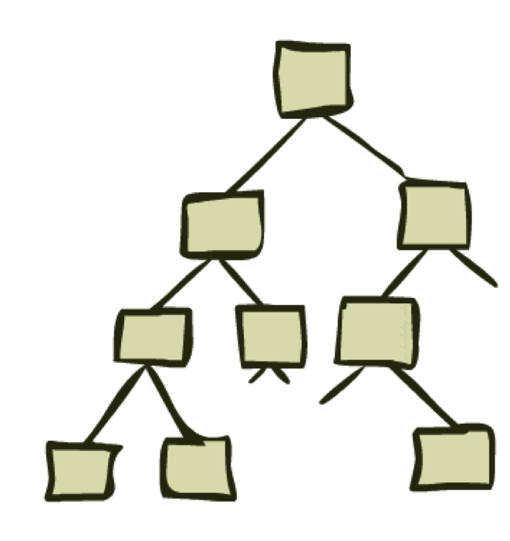
Search Trees

Slide 16
Search Trees
This is now / start
“N”, 1.0
“E”, 1.0
Possible futures
A search tree:
A “what if” tree of plans and their outcomes
The start state is the root node
Children correspond to successors
Nodes show states, but correspond to PLANS that achieve those states
For most problems, we can never actually build the whole tree
Notes:
Different plans that achieve the same state, will be different nodes in the tree.

Slide 17
State Space Graphs vs. Search Trees
State Space Graph
Each NODE in in the search tree is an entire PATH in the state space graph.
Search Tree
S
a
G
d
e
p
b
c
q
b
c
e
h
r
d
e
f
a
a
h
r
p
q
f
S
h
We construct both on demand – and we construct as little as possible.
p
q
f
q
c
G
p
q
r
q
c
G
a
a

Slide 18

Depth-First Search

Slide 19
Depth-First Search
Strategy: expand a deepest node first
Implementation: Fringe is a LIFO stack
a
G
a
c
b
c
b
e
d
e
d
f
f
S
h
h
p
p
r
q
r
q
S
d
e
p
b
c
e
h
r
q
a
a
h
r
p
q
f
p
q
f
q
c
G
q
c
G
a
a

Slide 20
Depth-First Search
Depth-first search is a recursive algorithm for traversing a tree or graph data structure.
It is called the depth-first search because it starts from the root node and follows each path to its greatest depth node before moving to the next path.
DFS uses a stack data structure for its implementation.

Slide 21
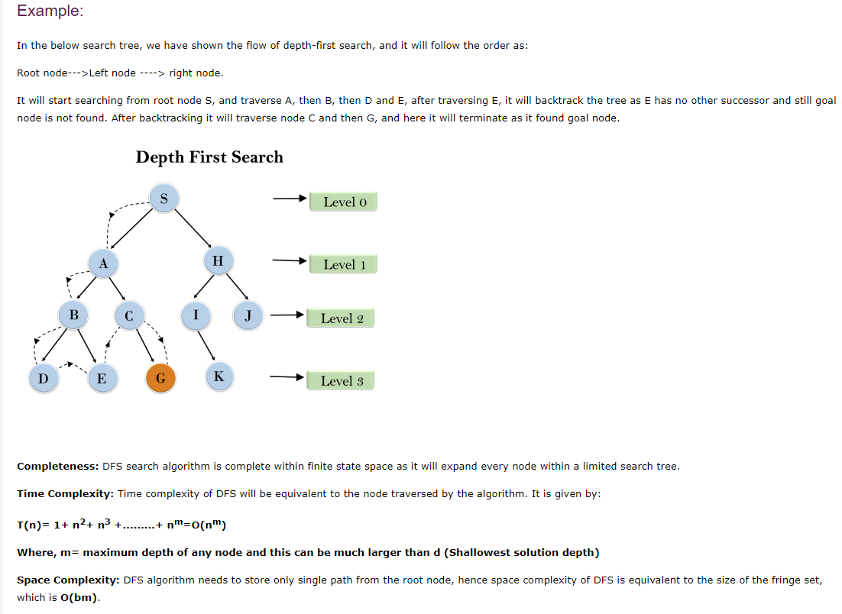
Depth-First Search

Slide 22
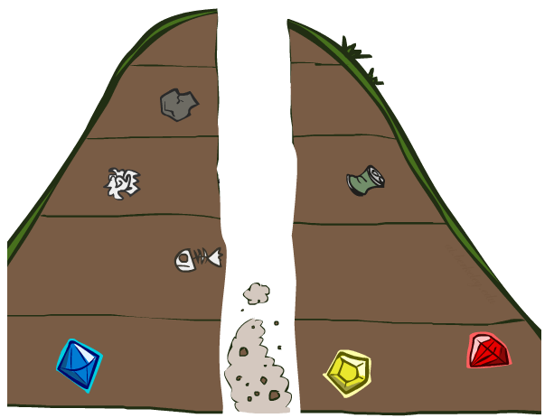
Search Algorithm Properties

Slide 23
Search Algorithm Properties
Complete: Guaranteed to find a solution if one exists?
Optimal: Guaranteed to find the least cost path?
Time complexity?
Space complexity?
Cartoon of search tree:
b is the branching factor
m is the maximum depth
solutions at various depths
Number of nodes in entire tree?
1 + b + b² + …. b^{m} = O(b^{m})
1 node
b
…
b nodes
b² nodes
m tiers
b^{m} nodes

Slide 24
Depth-First Search (DFS) Properties
What nodes DFS expand?
Some left prefix of the tree.
Could process the whole tree!
If m is finite, takes time O(b^{m})
How much space does the fringe take?
Only has siblings on path to root, so O(bm)
Is it complete?
m could be infinite, so only if we prevent cycles (more later)
Is it optimal?
No, it finds the “leftmost” solution, regardless of depth or cost
1 node
b
…
b nodes
b² nodes
m tiers
b^{m} nodes

Slide 25
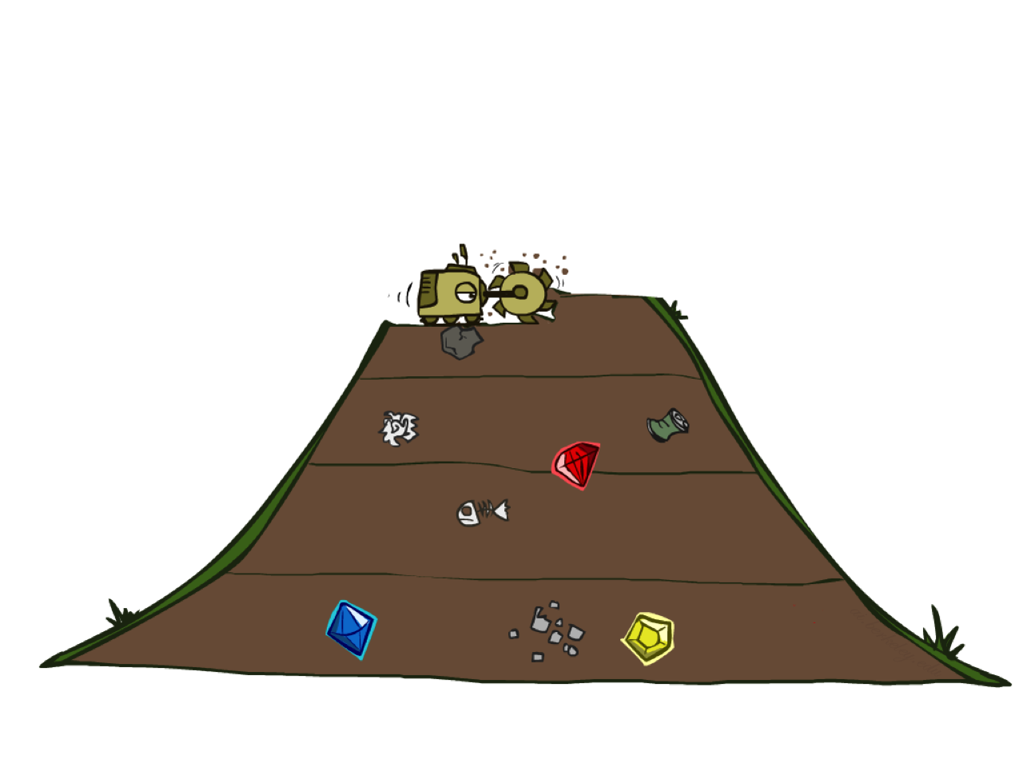
Breadth-First Search
Breadth-first search (BFS) is an algorithm for searching a tree data structure for a node that satisfies a given property. It starts at the tree root and explores all nodes at the present depth prior to moving on to the nodes at the next depth level. Extra memory, usually a queue, is needed to keep track of the child nodes that were encountered but not yet explored.
Notes:
Breadth-first search (BFS) is an algorithm for searching a tree data structure for a node that satisfies a given property. It starts at the tree root and explores all nodes at the present depth prior to moving on to the nodes at the next depth level. Extra memory, usually a queue, is needed to keep track of the child nodes that were encountered but not yet explored.

Slide 26
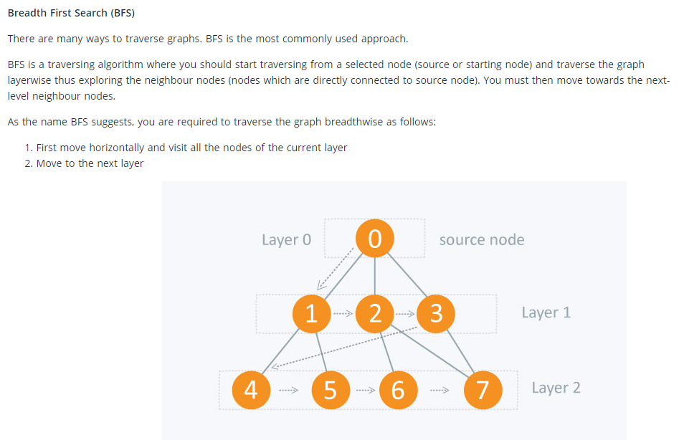
Breadth-First Search

Slide 27
Breadth-First Search
Strategy: expand a shallowest node first
Implementation: Fringe is a FIFO queue
a
G
b
c
d
e
f
S
h
p
q
r
S
d
e
p
Search
Tiers
b
c
e
h
r
q
a
a
h
r
p
q
f
p
q
f
q
c
G
q
c
G
a
a

Slide 28
Breadth-First Search (BFS) Properties
What nodes does BFS expand?
Processes all nodes above shallowest solution
Let depth of shallowest solution be s
Search takes time O(b^{s})
How much space does the fringe take?
Has roughly the last tier, so O(b^{s})
Is it complete?
s must be finite if a solution exists, so yes!
Is it optimal?
Only if costs are all 1 (more on costs later)
1 node
b
…
b nodes
s tiers
b² nodes
b^{s} nodes
b^{m} nodes

Slide 29
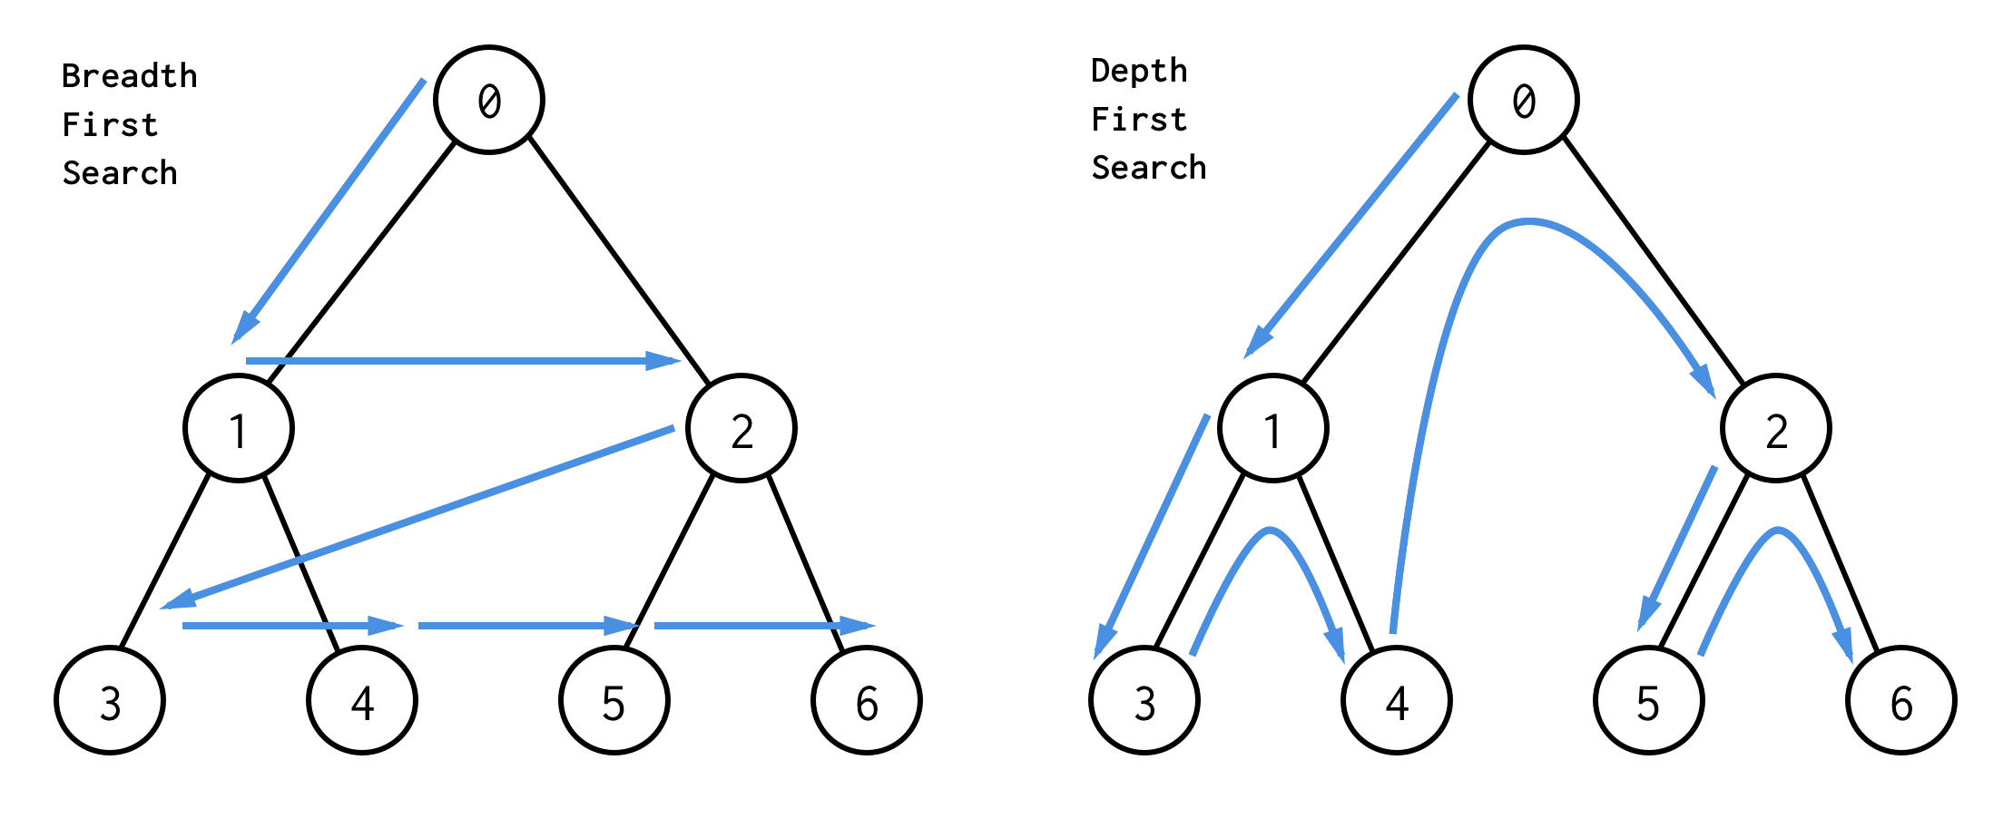
DFS vs BFS

Slide 30
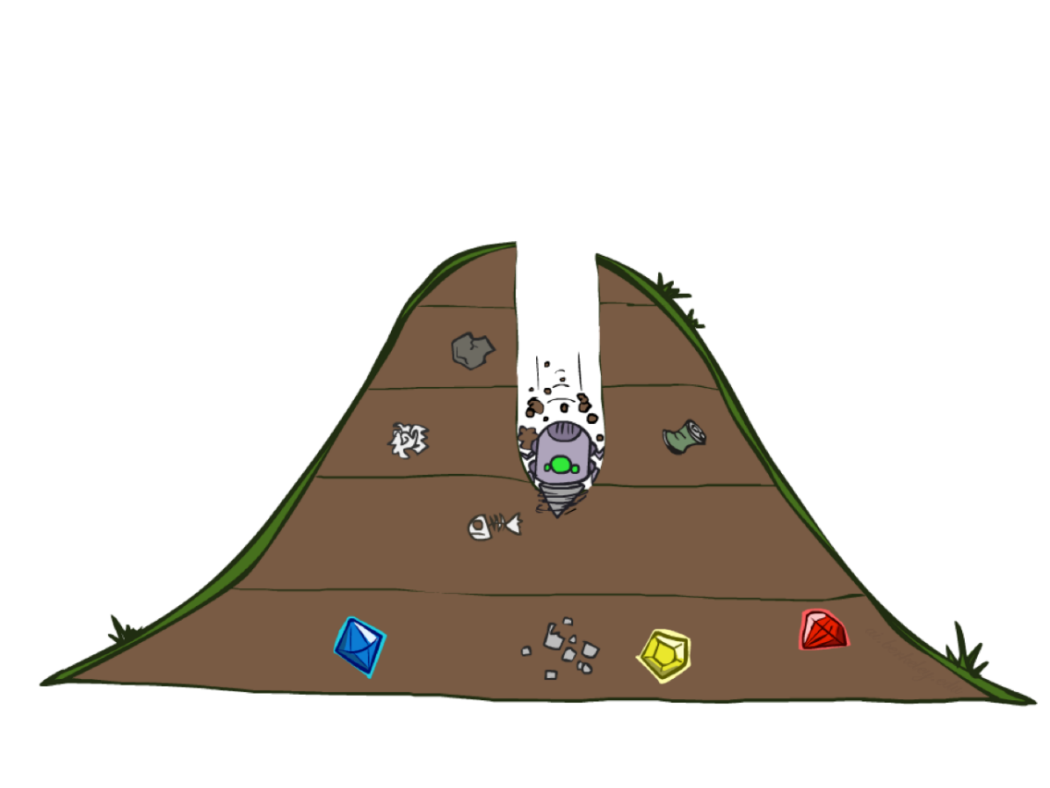
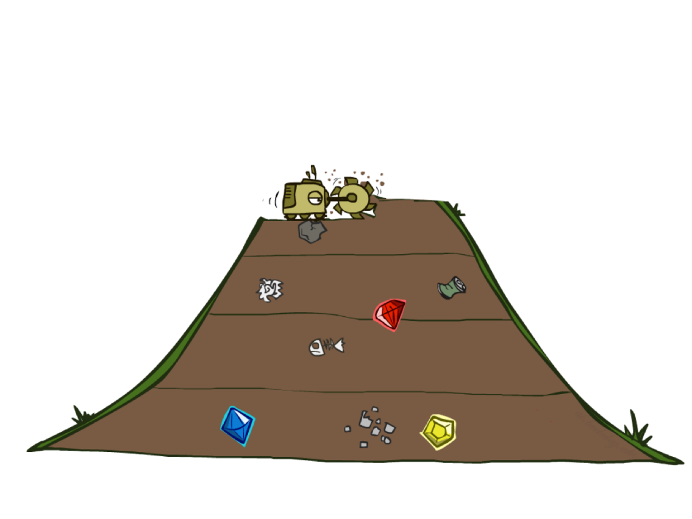
Quiz: DFS vs BFS

Slide 31

Video of Demo Maze Water DFS/BFS (part 1)

Slide 32
Video of Demo Maze Water DFS/BFS (part 2)

Slide 33
Iterative Deepening
Idea: get DFS’s space advantage with BFS’s time / shallow-solution advantages
Run a DFS with depth limit 1. If no solution…
Run a DFS with depth limit 2. If no solution…
Run a DFS with depth limit 3. …..
Isn’t that wastefully redundant?
Generally most work happens in the lowest
level searched, so not so bad!
b
…

Slide 34
Cost-Sensitive Search
a
GOAL
2
2
b
c
3
2
1
8
2
e
d
f
3
9
8
2
START
h
1
4
2
p
4
r
15
q
BFS finds the shortest path in terms of number of actions.
It does not find the least-cost path. We will now cover
a similar algorithm which does find the least-cost path.

Slide 35

Uniform Cost Search
Uniform-cost search is an uninformed search algorithm that uses the lowest cumulative cost to find a path from the source to the destination. Nodes are expanded, starting from the root, according to the minimum cumulative cost.

Slide 36
Uniform Cost Search
2
G
a
Strategy: expand a cheapest node first:
Fringe is a priority queue (priority: cumulative cost)
b
c
1
8
2
2
e
3
d
f
9
8
2
S
h
1
1
p
q
r
15
0
S
d
3
e
9
p
1
b
4
e
5
h
17
r
11
q
16
c
11
Cost contours
a
6
a
h
13
r
7
p
q
f
p
q
f
8
q
c
G
q
c
a
11
G
10
a

Slide 37
Uniform Cost Search (UCS) Properties
What nodes does UCS expand?
Processes all nodes with cost less than cheapest solution!
If that solution costs C* and arcs cost at least ε , then the “effective depth” is roughly C*/ε
Takes time O(b^{C*/ε}) (exponential in effective depth)
How much space does the fringe take?
Has roughly the last tier, so O(b^{C*/ε})
Is it complete?
Assuming best solution has a finite cost and minimum arc cost is positive, yes!
Is it optimal?
Yes! (Proof next lecture via A*)
b
c ≤ 1
…
C*/ε “tiers”
c ≤ 2
c ≤ 3

Slide 38
Uniform Cost Issues
Remember: UCS explores increasing cost contours
The good: UCS is complete and optimal!
The bad:
Explores options in every “direction”
No information about goal location
We’ll fix that soon!
…
c ≤ 1
c ≤ 2
c ≤ 3
Start
Goal

Slide 39
Video of Demo Empty UCS

Slide 40
Video of Demo Maze with Deep/Shallow Water --- DFS, BFS, or UCS? (part 1)

Slide 41
Video of Demo Maze with Deep/Shallow Water --- DFS, BFS, or UCS? (part 2)

Slide 42
Video of Demo Maze with Deep/Shallow Water --- DFS, BFS, or UCS? (part 3)

Slide 43
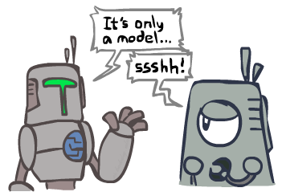
Search and Models
Search operates over models of the world
The agent doesn’t actually try all the plans out in the real world!
Planning is all “in simulation”
Your search is only as good as your models…

Slide 44
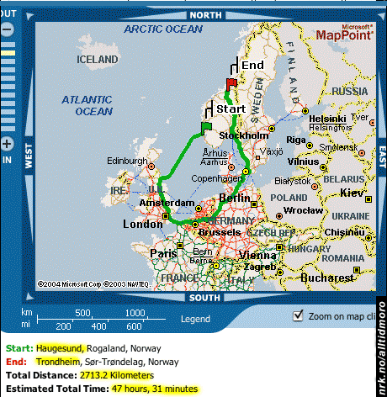
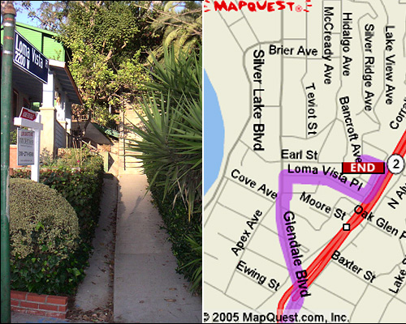
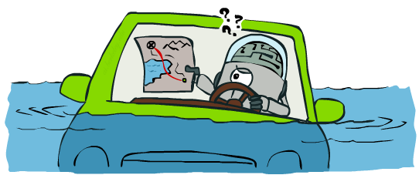
Search Gone Wrong?

Slide 45
Recap: Search

Slide 46
Recap: Search
Search problem:
States (configurations of the world)
Actions and costs
Successor function (world dynamics)
Start state and goal test
Search tree:
Nodes: represent plans for reaching states
Plans have costs (sum of action costs)
Search algorithm:
Systematically builds a search tree
Chooses an ordering of the fringe (unexplored nodes)
Optimal: finds least-cost plans

Slide 47
End of the Week…

